Slide 1

RadOnc Clinical Trial Dashboard Training
September 25, 2023
Molly Voss, Michael Golafshar
Notes:
Utilize the R prog lang to build interactive quality of life reports

Slide 2

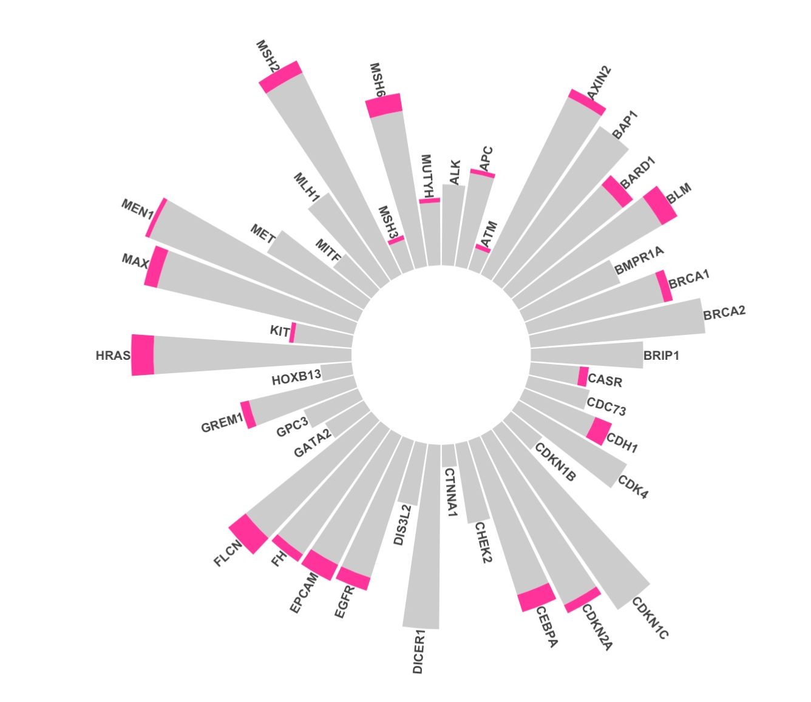

Welcome / Session Outline
Get set up
RMD / Dashboard Basics
Clinical Trial Dashboard (from scratch)
Notes:
best way to handle missing data is to stop it from being missing.

Slide 3
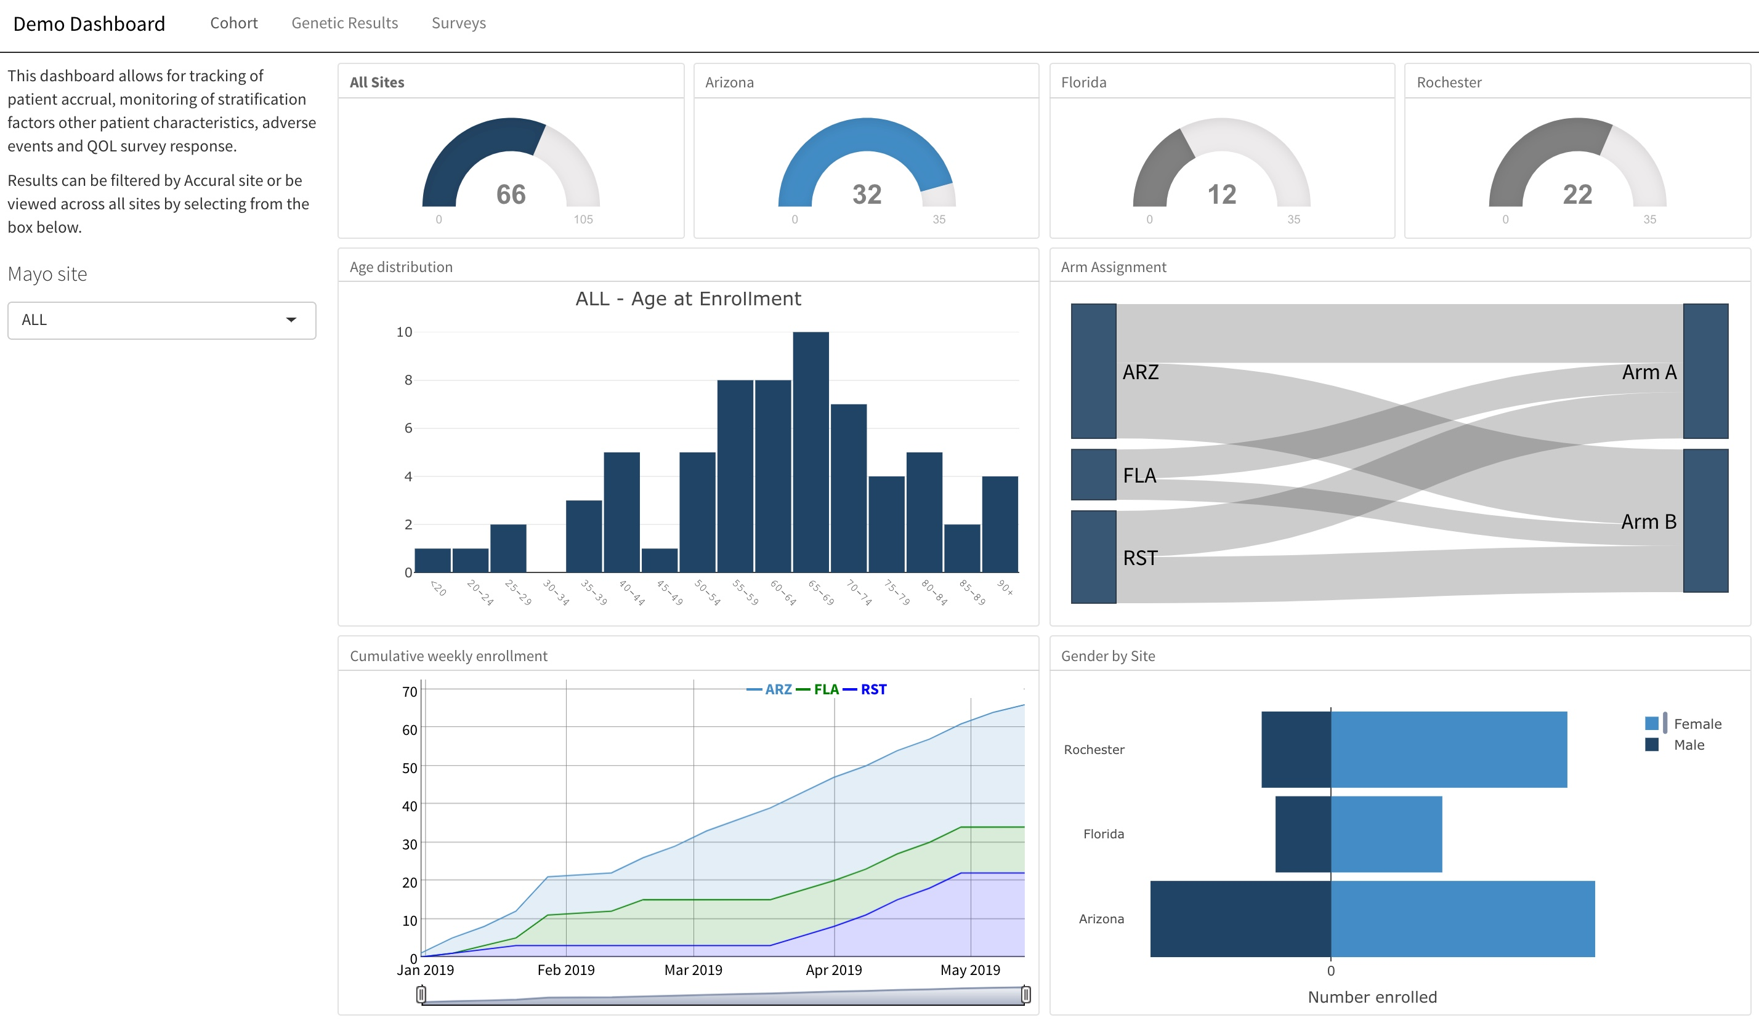
Why Create Dashboards?
All of your data is on demand
Less time spent on regular report/requests
Study team has all of the information they need in one place
Notes:
On Demand
With this data at our fingertips we can grab patients as they come in for visits
Which leads to increased protocol adherence
-by keeping investigators and CRCs up to date on potentially missing data
Who doesn’t want a dashboard
Issues – perception that it will take a long time and or cost a lot of money
- The focus of the remainder of this talk

Slide 4
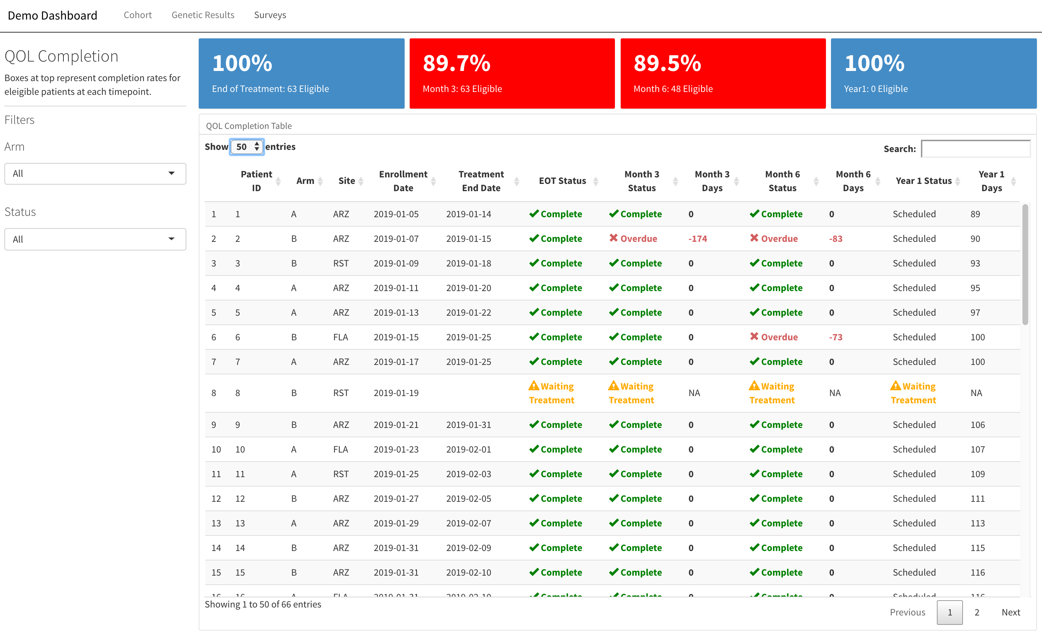
Why Create Dashboards?
Allows for real-time quality control
Relatively inexpensive
Saves money over the life of the trial
Not as difficult as it might seem
Notes:
On Demand
With this data at our fingertips we can grab patients as they come in for visits
Which leads to increased protocol adherence
-by keeping investigators and CRCs up to date on potentially missing data
Who doesn’t want a dashboard
Issues – perception that it will take a long time and or cost a lot of money
- The focus of the remainder of this talk

Slide 5
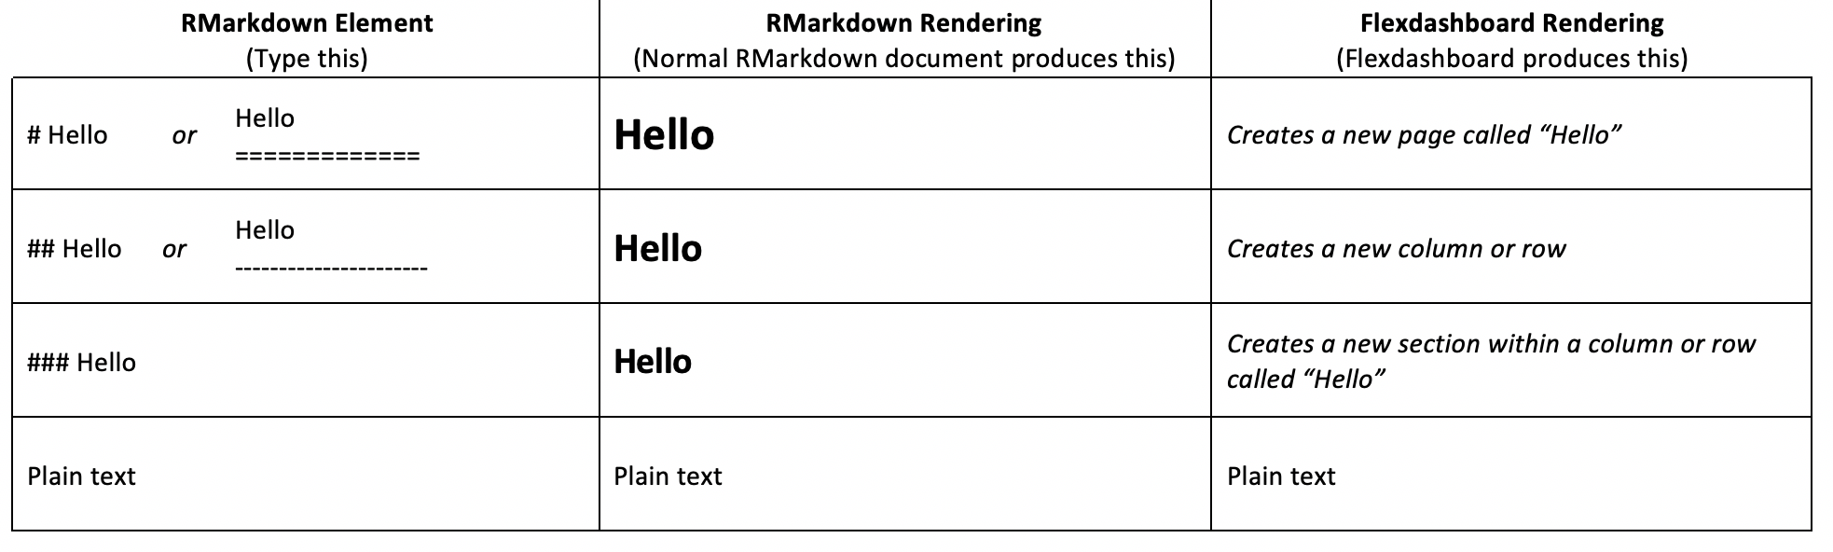
RMarkdown
RMarkdown : allows you to easily create reports and seamlessly combine text and code together in a single document. This helps with reproducibility.
YAML Markdown Code
Syntex
Code chuck
Options (results, echo, include)
How to knit
Flexdashboard
Uses RMarkdown to create dashboard
Most be row or column format
Anatomy and basic example
Notes:
best way to handle missing data is to stop it from being missing.

Slide 6
Anatomy of a Flexdashboard
---
title: “Demo Dashboard”
output: flexdashboard::flex_dashboard
---
Page 1
==================================
Column
-------------------------------------------------------
### Plot A
```{r}
CODE GOES HERE
```
YAML
Notes:
.
YAML – title and directions on how the document should be rendered

Slide 7
Anatomy of a Dashboard
---
title: “Demo Dashboard”
output: flexdashboard::flex_dashboard
---
Page 1
==================================
Column
-------------------------------------------------------
### Plot A
```{r}
CODE GOES HERE
```
RMarkdown
Notes:
.

Slide 8
Anatomy of a Dashboard
---
title: “Demo Dashboard”
output: flexdashboard::flex_dashboard
---
Page 1
==================================
Column
-------------------------------------------------------
### Plot A
```{r}
CODE GOES HERE
```
Code block
Notes:
.

Slide 9
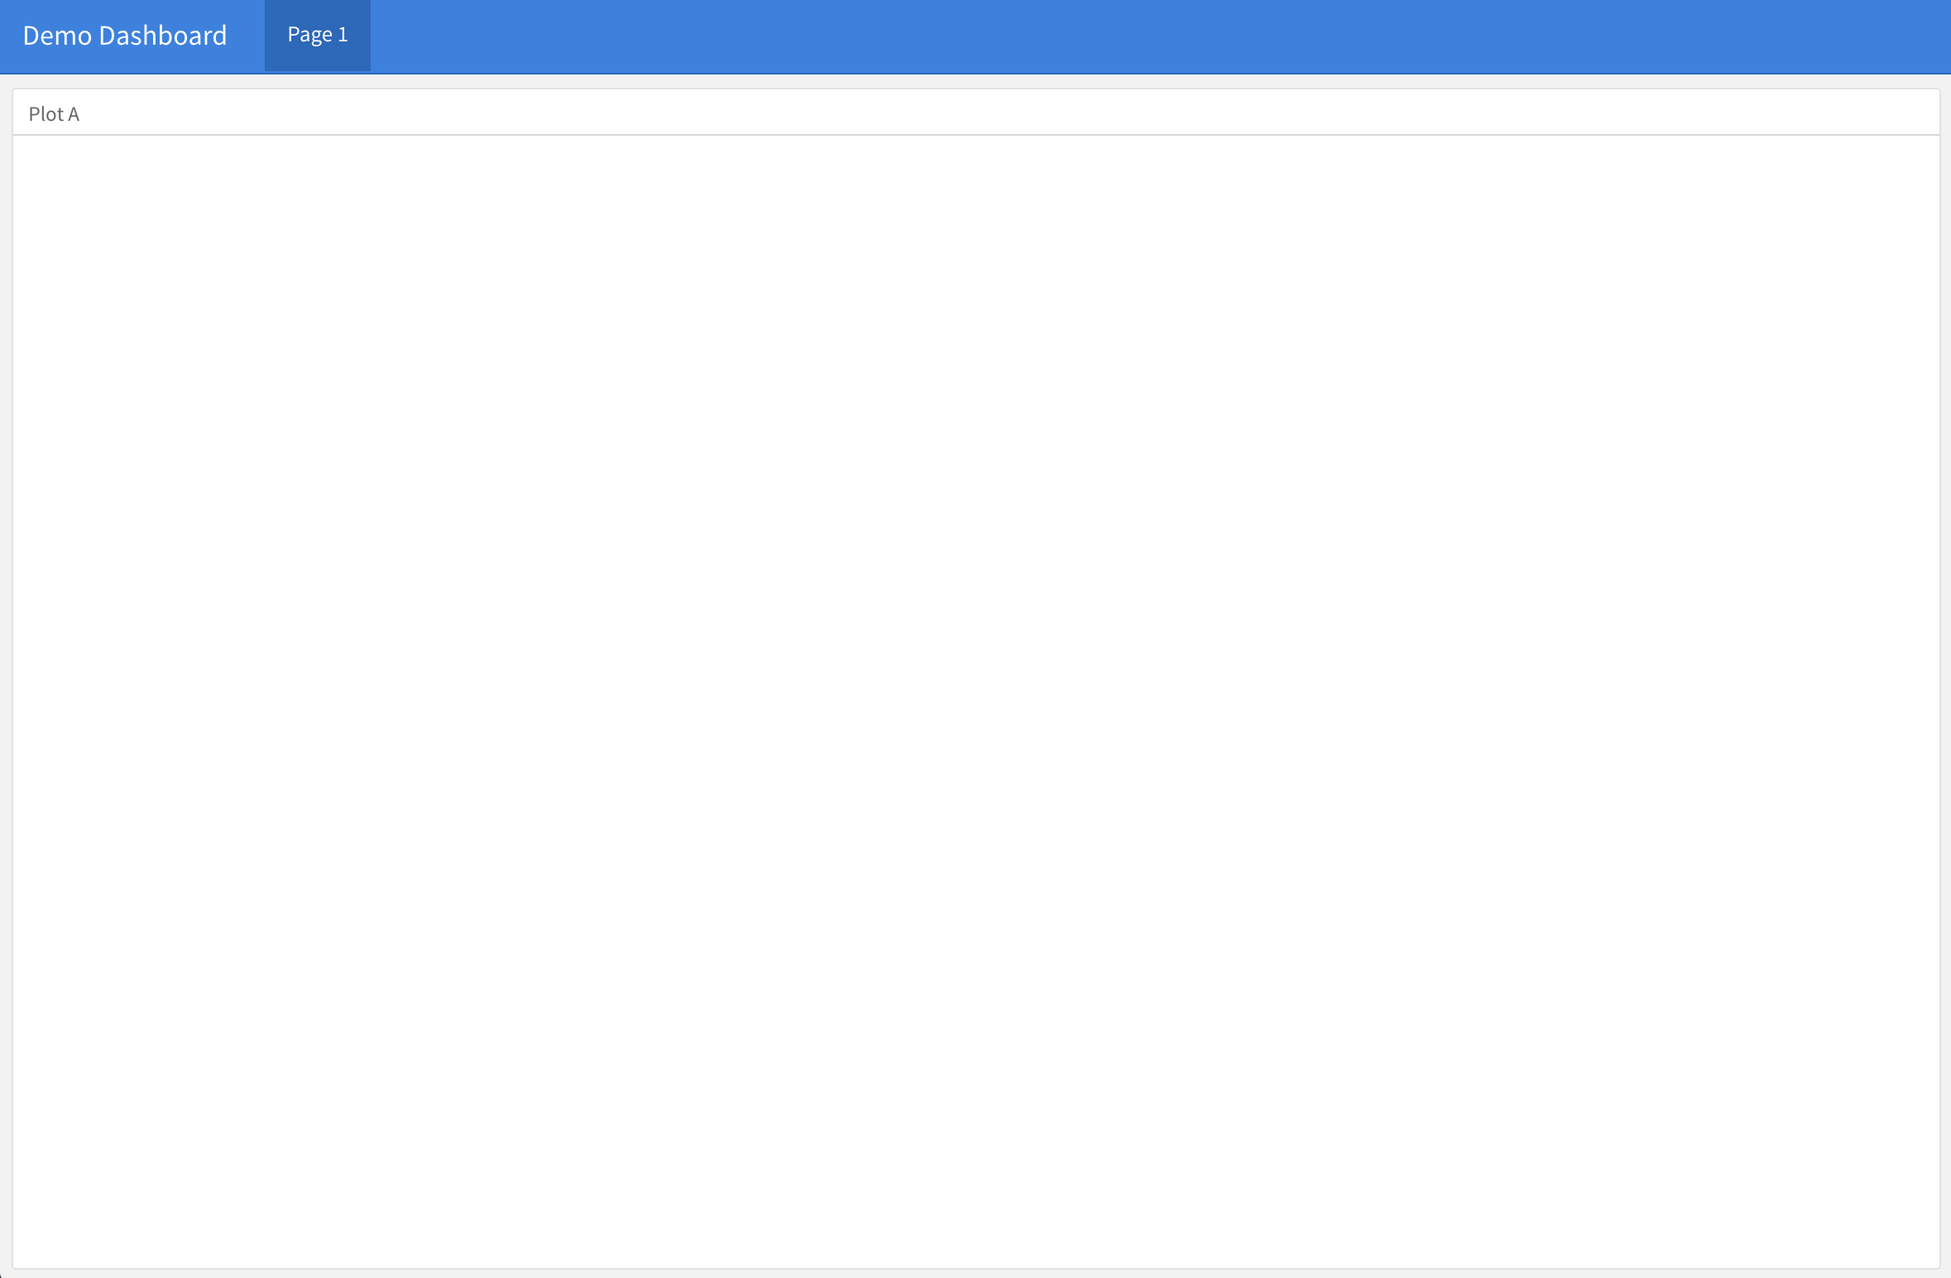

Slide 10
Constructing a Dashboard
---
title: ”Demo Dashboard"
output: flexdashboard::flex_dashboard
---
Page 1
==================================
Column {data-width=650}
-------------------------------------------------------
### Plot A
```{r}
CODE GOES HERE
```
Page 2
==================================
Let’s add a new page...
Page 2
==================================

Slide 11
Constructing a Dashboard
---
title: ”Demo Dashboard"
output: flexdashboard::flex_dashboard
---
Page 1
==================================
Column {data-width=650}
-------------------------------------------------------
### Plot A
```{r}
CODE GOES HERE
```
Surveys
==================================
with a more meaningful name.
Surveys
==================================

Slide 12
Constructing a Dashboard
---
title: ”Demo Dashboard"
output: flexdashboard::flex_dashboard
---
Demographics
==================================
Column {data-width=650}
-------------------------------------------------------
### Plot A
```{r}
CODE GOES HERE
```
Surveys
==================================
Rename the first tab.
Demographics
==================================

Slide 13
Constructing a Dashboard
---
title: ”Demo Dashboard"
output: flexdashboard::flex_dashboard
---
Demographics
==================================
Inputs {.sidebar }
-----------------------------------
Column {data-width=650}
-------------------------------------------------------
### Plot A
```{r}
CODE GOES HERE
```
Surveys
==================================
Add a sidebar...
Inputs {.sidebar }
---------------------------------

Slide 14
Constructing a Dashboard
---
title: ”Demo Dashboard"
output: flexdashboard::flex_dashboard
---
Demographics
==================================
Inputs {.sidebar }
---------------------------------
## Hello
I am some text in the sidebar.
Column {data-width=650}
-------------------------------------------------------
### Plot A
```{r}
CODE GOES HERE
```
Surveys
==================================
Add a sidebar... with text.
Inputs {.sidebar }
---------------------------------
## Hello
I am some text in the sidebar.

Slide 15
Constructing a Dashboard
---
title: ”Demo Dashboard"
output: flexdashboard::flex_dashboard
---
Demographics
==================================
Inputs {.sidebar }
---------------------------------
#### __Hello__
I am some text in the sidebar.
Column
-------------------------------------------------------
### Plot A
```{r}
CODE GOES HERE
```
Column
-------------------------------------------------------
### Plot B
### Plot C
Surveys
==================================
A second column… with 2 sections.
Column
----------------------------------------------------
### Plot B
### Plot C

Slide 16
Constructing a Dashboard
---
title: "Demo Dashboard"
output: flexdashboard::flex_dashboard
---
Demographics
==================================
Inputs {.sidebar }
---------------------------------
#### __Hello__
I am some text in the sidebar.
Column
-------------------------------------------------------
### Accrual
```{r}
CODE GOES HERE
```
Column
-------------------------------------------------------
### Gender
### Age
Surveys
==================================
Let’s add better section names.
### Accrual
### Gender
### Age

Slide 17
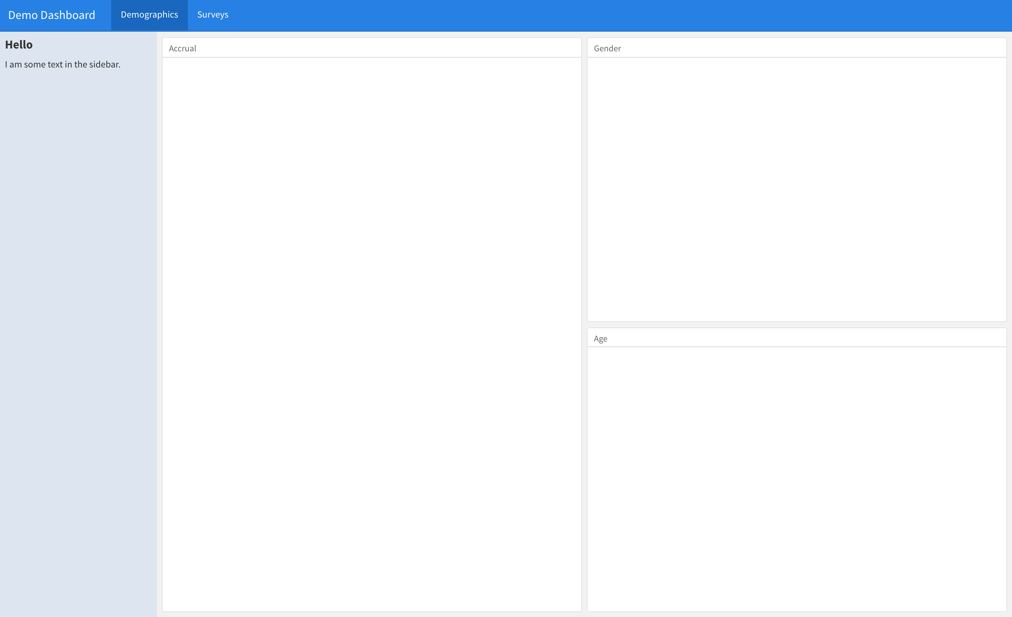

Slide 18
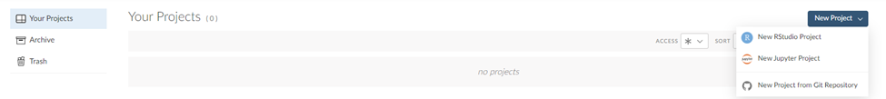
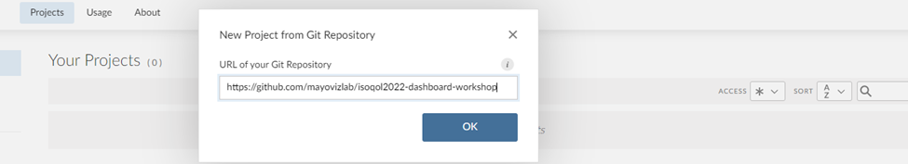
Getting Set Up – Download Samples
Create a project to save your work from the workshop from a Git Repository. See the screenshot below.
After clicking "New Project from Git Repository" under the "New Project" drop down please enter the URL below into the prompt. https://github.com/mayovizlab/clinicaltrial_dashboard_training.git
And click okay to download the project. This will create a project with all the material we will use during the workshop pre-loaded for you.
https://github.com/mayovizlab/clinicaltrial_dashboard_training
Notes:
R
- Programming language developed by statisticians
- Grown tremendously over the las 10 years
- very lively user base
Rmarkdown
- R’s implementation of markdown language
-used for applying inline style to text primarily for publishing to the web
Flexdashboard
- library created by the RStudio team.
- provides structure by borrowing elements from RMarkdown
Shiny
Allows you to embed reactive elements in the dashboard
not necessary if you don't want to filter / sort ,etc.

Slide 19
Deploy
Static Reports/Dashboards
Nothing additional required
Dynamic Dashboards
Needs to be hosted on a server with R installed
shinyapps.io – hosting service by Rstudio
Shiny Server – can be set up by your institution
RStudio Connect – full publishing platform from Rstudio
Share your code with someone else – requires that they have and can use R ☺

Slide 20
Deploy
Static Reports/Dashboards
Nothing additional required
Dynamic Dashboards
Needs to be hosted on a server with R installed
shinyapps.io – hosting service by Rstudio
Shiny Server – can be set up by your institution
RStudio Connect – full publishing platform from Rstudio
Share your code with someone else – requires that they have and can use R ☺

Slide 21
Thank you!
Questions:
Michael Golafshar, MS
golafshar.michael@mayo.edu
Molly Voss
voss.molly@mayo.edu

